Slide 1
Netflix like Encoding Optimization (Intermediate Presentation)
Vijaykumar Singh Rana
Audiovisual Technology Group
Institute for Media Technology
TU Ilmenau

Slide 2
Contents
Motivation
Introduction
Per Title Encode Optimization
Optimized Shot-based Encodes
VMAF
Implementation and Progress
Platforms
Next Steps
1

Slide 3
Motivation
Investigation for alternate approach to Netflix’s brute force approach
Approximation with the sparse data points to generate the similar results as Netflix’s approach
Evaluation of simple and fast computation based on sparse data for reliability

Slide 4
Introduction
VoD service providers require to provide services with perceivable quality
Netflix, Prime Video, YouTube
DASH for delivery services (Transmission)
Chunked data retrieved and provided to end user
Sophisticated Video Encoding Schemes (Encoded Video Data)
Discarding one-size-fits-all approach

Slide 5
Per Title Encode Optimization
One-size-fits-all or fixed bit-rate ladder has its limitation:
Camera noise, film grain noise, blockiness even at high bitrates(e.g., 5.8Mbps) [1]
Bandwidth constraints plays a major role
Solution is to optimize the bit-rate ladder
Notes:
Each resolution has its pair with bit-rate
Customers with limited bandwidth cannot enjoy hd content
Calculate optimal bitrate for each quality for EACH VIDEO(efficient bitrate-resolution pair)

Slide 6
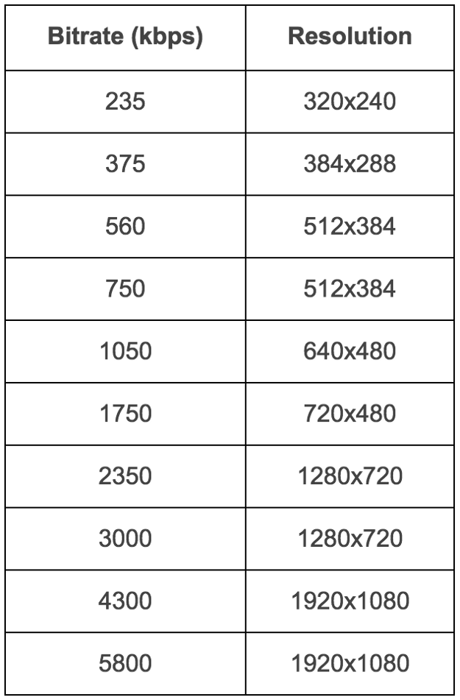
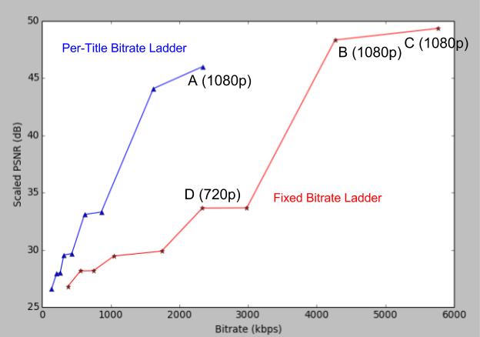
Per Title Encode Optimization
Fig. 1. Fixed bit-rate Resolution pairs (left), Per-Title Bitrate Ladder vs Fixed Bitrate Ladder for an animated video (right) [1]

Slide 7
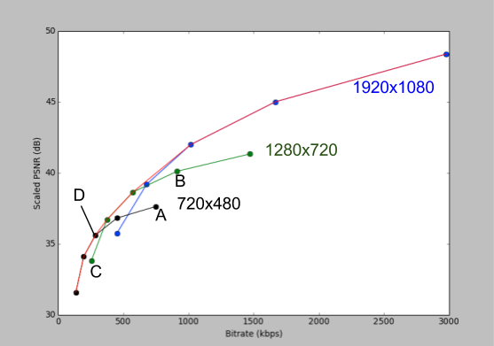
Per Title Encode Optimization
Fig. 2. Rate- Quality function of convex hull [1]

Slide 8
Optimized Shot-based Encodes
Granular approach to encode a video
Offers higher compression efficiency
Netflix uses the techniques of Collation and Checkpoints
Next step evaluation with VMAF

Slide 9
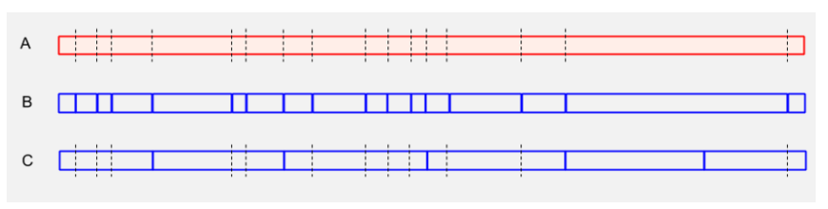
Optimized Shot-based Encodes
Fig. 3. Collation of shots into ‘chunks’. (A) Representation of a video timeline. The dashed vertical black lines represent shot boundaries. (B) One shot in one chunk: Each shot is assigned a chunk. (C) Collate shots into a chunk: Accumulate integer number of shots within a target chunk duration. [2]

Slide 10
VMAF
Video Multimethod Assessment Fusion
Open Source, based on viewers’ perception (predicts subjective quality)
Fusion of elementary metrics with machine learning technique
image
VIF: Visual Information Fidelity
DLM: Detail Loss Fidelity
Motion
Temporal difference of adjacent frames [3]
Notes:
Other metrics like PSNR and SSIM does not consistently reflect human perception
To assign weights to elementary metrics
the rationale of separately measuring the loss of details which affects the content visibility, and the redundant impairment which distracts viewer attention.
a modified version of VIF where the loss of fidelity in each scale is included as an elementary metric.
Trained and tested using opinion scores obtained through a subjective experiment
Video Quality Model with Variable Frame Delay (VQM-VFD)state of the art

Slide 11
Implementation and Progress
Raw Video
Divide into Scenes (shots)
Generate Resolutions for Scenes
For each resolution generate bitrates(range(0.25, 10, 0.25))
Compute VMAF with the corresponding raw scene as reference
Fig. 4. Brute Force Pipeline

Slide 12
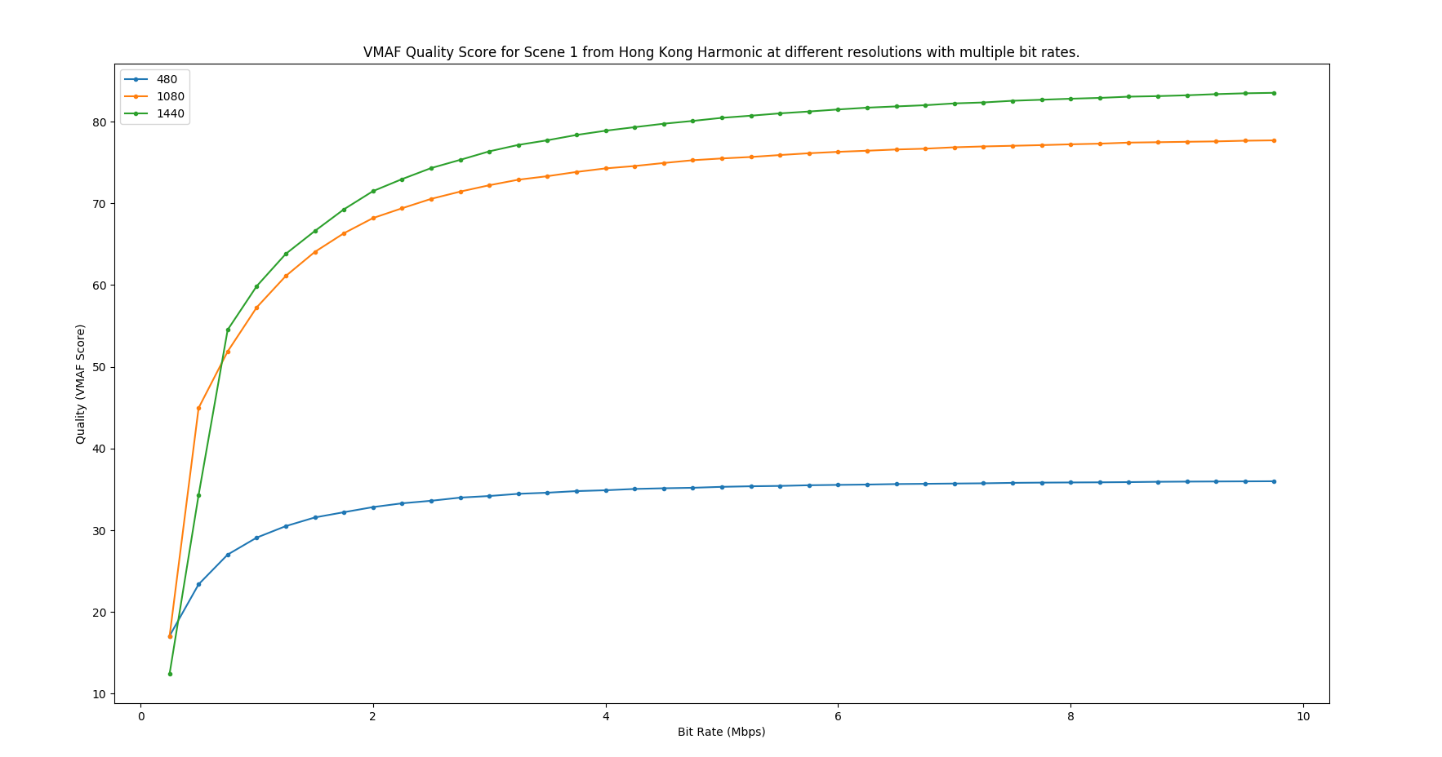
Implementation and Progress
Fig. 5. Rate – Quality plot

Slide 13
Platforms
FFMPEG – scaling, encoding and transcoding[4]
Scenedetect – Scene splitting with inter frame temporal information[5]
VMAF – Quality evaluation of videos

Slide 14
Next Steps
Approximate using sparse data points
Repeat the same pipeline of brute force and sparse data for other videos
Evolution and conclusion based on the result
Documentation…

Slide 15
References
https://medium.com/netflix-techblog/per-title-encode-optimization-7e99442b62a2
https://medium.com/netflix-techblog/optimized-shot-based-encodes-now-streaming-4b9464204830
https://medium.com/netflix-techblog/toward-a-practical-perceptual-video-quality-metric-653f208b9652
https://ffmpeg.org/
https://pyscenedetect.readthedocs.io/en/latest/

